Slide 1

Project#2 Evaluating The impact of varying Branch prediction parameters in an X86 architecture-based Microprocessor using Gem5 simulator
Under: Prof DR. Kanad Basu
Team: (100/100) Abhinay Dwadasi (AXD220054)
Yagna Srinivasa Harsha Annadata (yxa210024)
(CE6304) Class of 2023-24 (Spring Semester)

Slide 2
Project Description:
Evaluating the efficiency of various branch predictors on X86 MP using GEM5.
CPU type: Timing Simple CPU.
CPU configuration:
128 kB for L1 Instruction cache.
128 kB for L1 Data cache.
1024 kB for L2 cache.
Associativity:
For L1D and L1I: 2-way Set associative.
For L2: 4-way set associative.
Cache Block Size: 64 bytes.
Benchmarks:
401.bzip2, 429.mcf, 456.hmmr. 458.sjeng, 470.lbm
Branch Predictors:
2 bit-Local branch predictor.
Bi_mode branch predictor
Tournament predictor.
Standard Instruction Load: 500000000

Slide 3
What is branch prediction ?
Branch prediction is a technique used in computer architecture to improve the performance of pipelined processors.
Branch prediction is used to guess the target address of the branch instruction before it is determined. This is done with the help of a branch predictor.
A branch predictor makes an educated guess based on the past behavior of the program or code pattern.

Slide 4
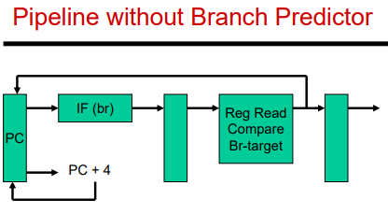
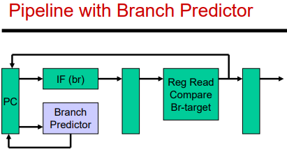
How can a Branch predictor affect the performance of a Processor?
The goal of branch prediction is to reduce the number of pipeline stalls caused by branch instructions and improve the overall performance of the processor. As you can see above, instead of fetching fall through instructions, a branch predictor will automatically jump to the address based on the algorithm used by the implemented predictor that reduces stalls for flushing and re-fetching appropriate instructions.
** cited images from University of UTAH CS6810 slides.

Slide 5
Types of Branch predictors
Bi_Mode Branch Predictor | Local Branch Predictor | Tournament Branch Predictor
The bi_mode predictor is a type of branch predictor that maintains a two tables of branch buffers; taken and not taken branch outcomes. Second level two-bit counter table is divided into two along with the branch address and the branch predictor state machine(PC). Branch address is used to make the final call This predictor works well for programs with equal probability of branch taken and not taken. | The local predictor is a more sophisticated type of branch predictor that considers the behavior of the branch instructions in a local region of the program. It maintains a table of branch histories for each region of the program and uses that information to predict the outcome of a branch instruction within that region. More effective for programs with more complex control flow structures. | The tournament predictor is a hybrid type of branch predictor that combines the strengths of the bimodal and local predictors. It maintains both a bimodal table and a local history table and selects the predictor that has been more accurate for the given branch instruction in the past. The tournament predictor uses a meta-predictor to choose the most accurate predictor for a particular branch instruction.

Slide 6
GEM5 configuration
Gem5 was accessed from the virtual server CE6304.utdallas.edu
Files have been copied from Gem5 directory (/usr/local/gem5). Configuration files have been moved to local directory using “cp rf-” command.
We used “scons build/X86/gem5.opt” after copying the files to build and compile Gem5.
Similar to Project 1, we still run the built CPU in system emulation mode using the following Python script: “/configs/example/se.py”.
Minor challenge that we have faced: While initially setting up gem5, we used the same files project 1, we were not able to build gem5 using previous files from some reason and hence, all the old files were deleted, and a fresh copy of the dependency files were copied. Post which we were able to successfully build and compile Gem5 simulator.

Slide 7
Challenges faced
The initial setup takes a longer time to build approximately 2 hours.
After every change to the Branch Predictor type or value we had to build and then run the run.sh file.
Hence every execution has taken approximately 30 min to complete except for 470.lbm benchmark.
for adding BTB Miss percent and Branch Misprediction percentage to stats.txt, there was difficulty initially to find the files which are to be changed. We later used grep -r “numBranches” --include="*.cc" --include="*.hh" to find the files and grep -r “BTBHitPct” --include="*.cc" --include="*.hh"

Slide 8


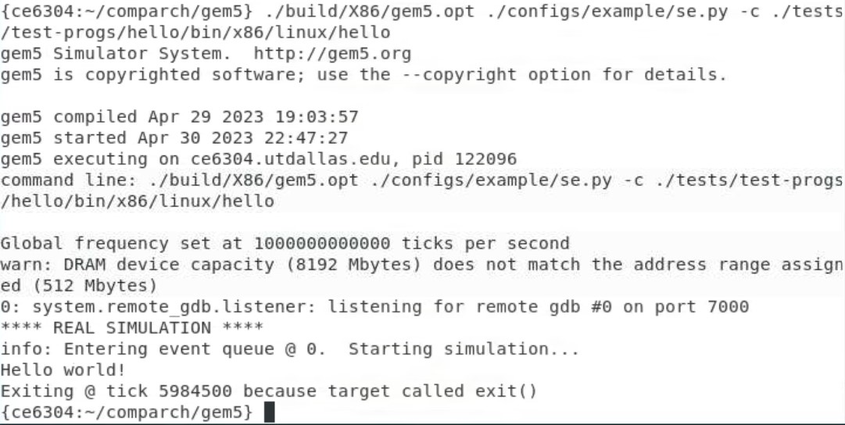
Initial Setup
We then downloaded the required benchmarks from github using: https://github.com/timberjack/Project1_SPEC.
Made changes to the source code according to the requirement.
Then we used scons build/X86/gem5.opt for building the executable file.
Ran the example programs for verification as shown in the figure.

Slide 9
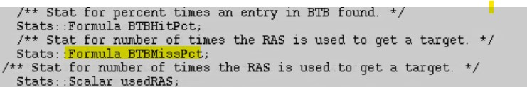
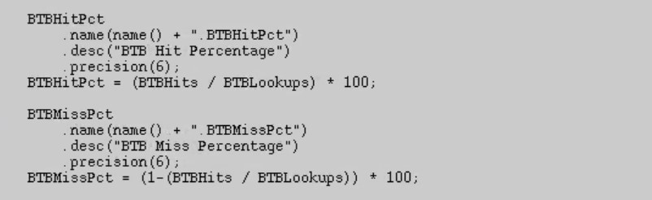
adding formula for reflecting BTB Miss percent in Stats.txt file
Following are the changes that have been made to the files in the following paths:
File path 1: ~gem5/src/cpu/pred/bpred_unit.hh
File Path2: ~gem5/src/cpu/pred/bpred_unit.cc

Slide 10
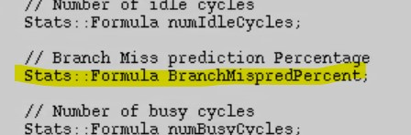
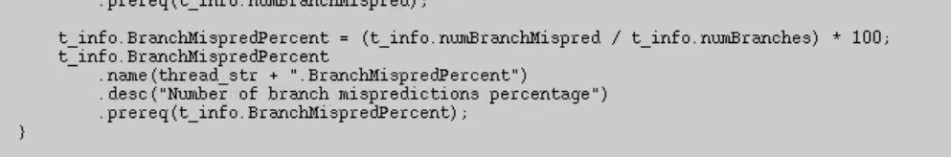
adding formula for reflecting Branch Misprediction in Stats.txt file
Following are the changes that have been made to the files in the following paths:
File path: ~/gem5/src/cpu/simple/exec_context.hh
File path: ~/gem5/src/cpu/simple/base.cc

Slide 11
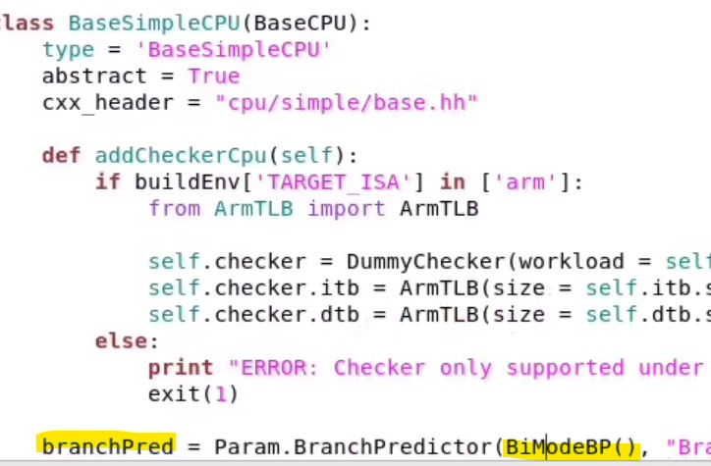
Changes for the Name of Branch Predictor
FilePath: ~/gem5/src/cpu/simple/BaseSimpleCPU.py
We give the Branch Predictor required in the highlighted space.

Slide 12
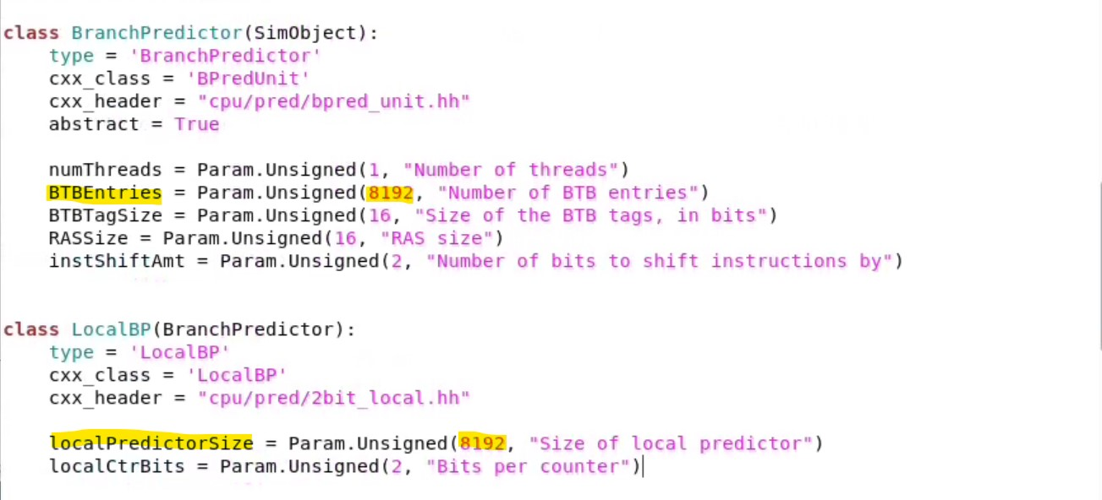
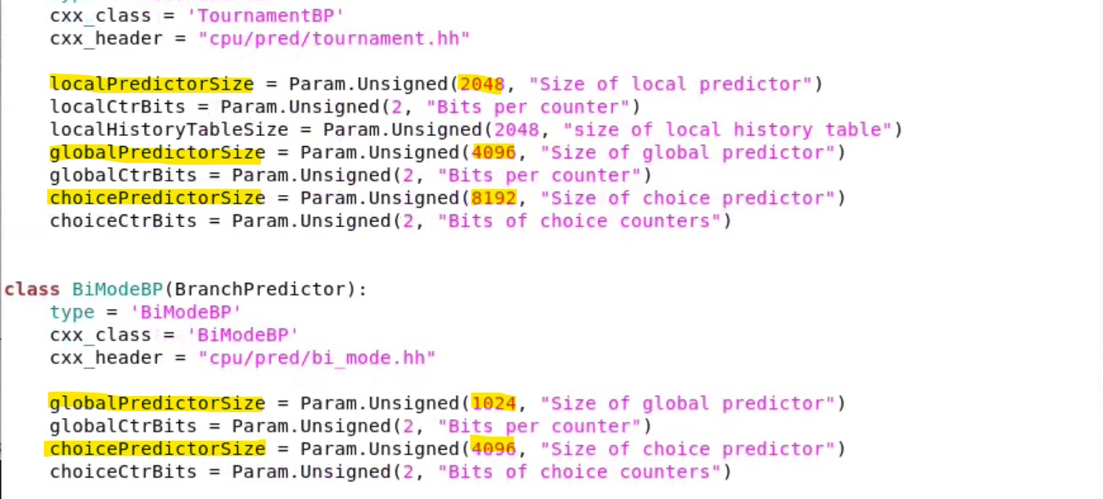
Changes for Branch Predictor Values
File Path for the values of Branch Predictor ~/gem5/src/cpu/pred/BranchPredictor.py
Values of the Branch Predictors are given according to the requirement in the highlighted space

Slide 13
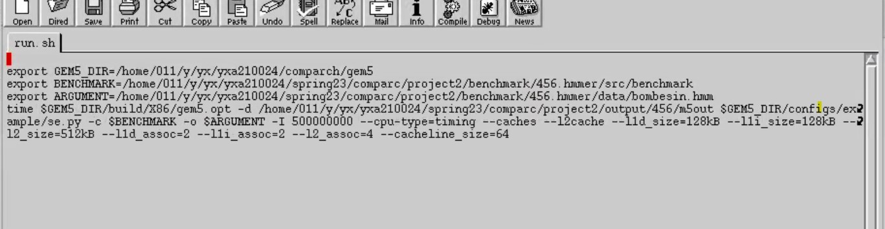
Running Gem5 Script
We have used a run.sh script to run the gem5 command in each benchmark.
Filepath: ~/benchmark/456.hmmer/run.sh
We modified the run.sh file according to the requirement as shown in figure.
We have allowed permission to run executable files by using chmod +x run.sh
On terminal we have run the executable file using ./run.sh

Slide 14
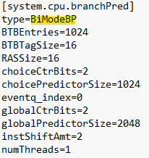
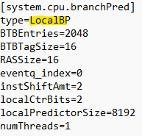
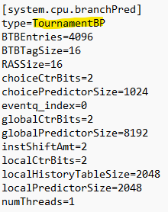
Changes Observed in Config.ini file after adding branch predictor support and making changes for the parameters
Bi_mode predictor
Local predictor
Tournament Predictor

Slide 15
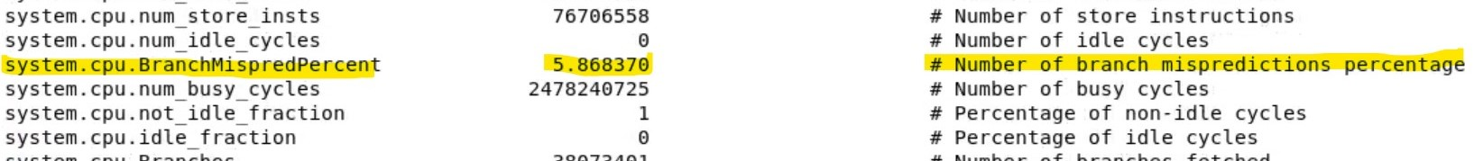
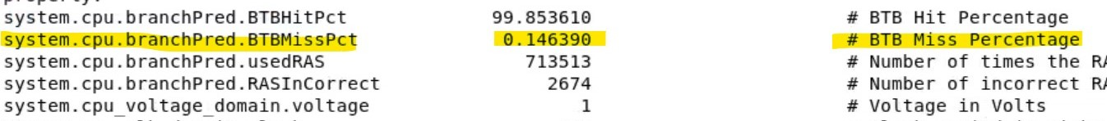
Changes Observed in stats.txt file after adding branch predictor support and making changes for the parameters

Slide 16
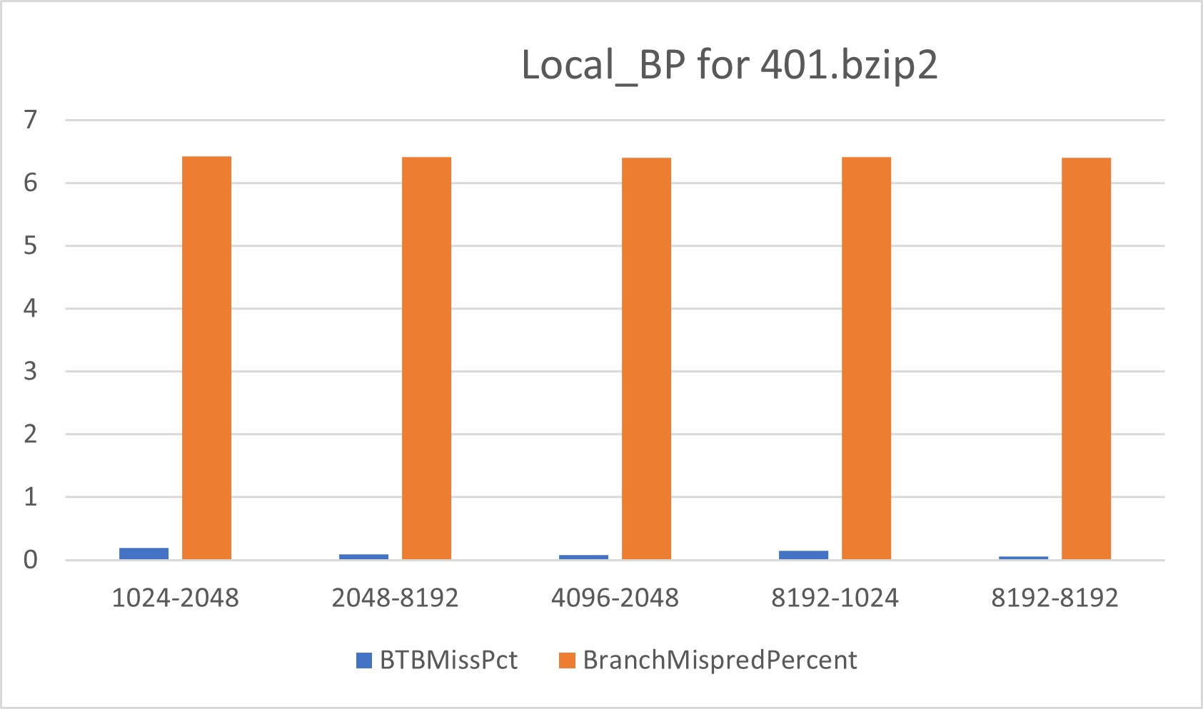
Local BP for 401.bzip2
There is only very slight variation in BTB miss percentage and branch miss prediction percentage with changes in the BTB entries and local predictor size.
However, as we increase the predictor size and the BTB buffer size the number of misses were seen to be considerably reduced.

Slide 17
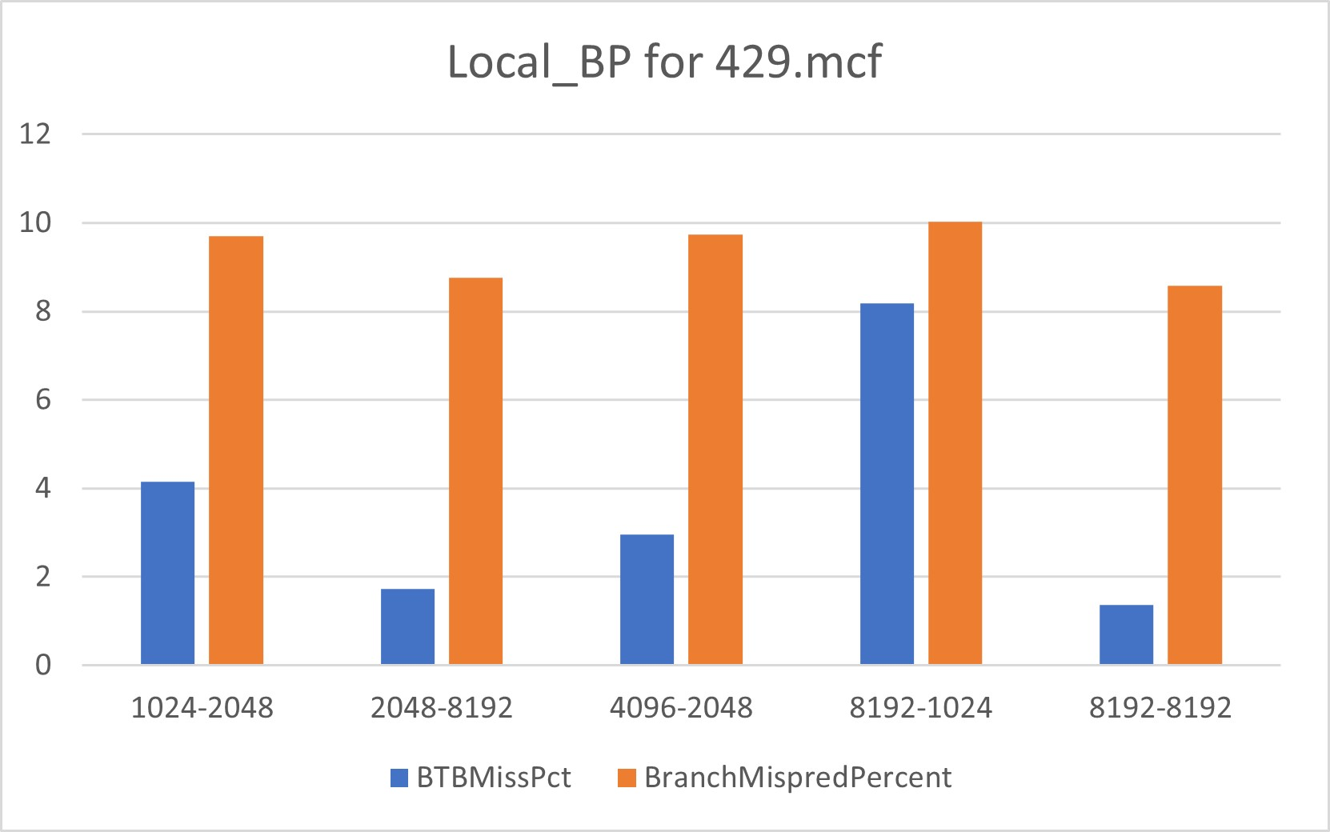
Local BP for 429.mcf
There is an irregular trend in BTB miss percentage and a little variation in branch miss prediction percentage with changes in the BTB entries and local predictor size.
But as the predictor size increases from 1024 to 8192 there was a drastic drop in the number of misses.

Slide 18
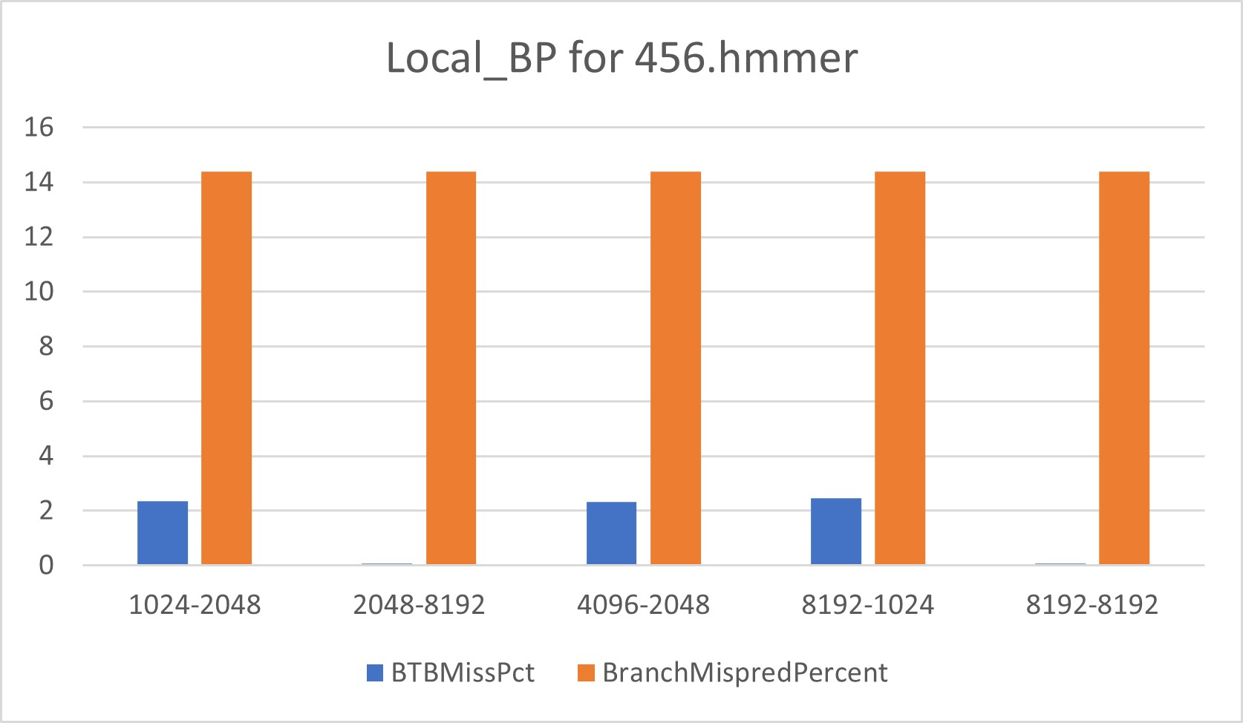
Local BP for 456.hmmer
For low value of local predictor size there is an increase in BTB miss percentage and branch miss prediction percentage stays almost constant with changes in the BTB entries and local predictor size.
For this benchmark it can be observed that the between 2048-8192 and 8192-8192 configurations the variation in BTB entries has not resulted in any changes in the BTB miss percent. The bigger the predictor, the lesser the miss percentage.

Slide 19
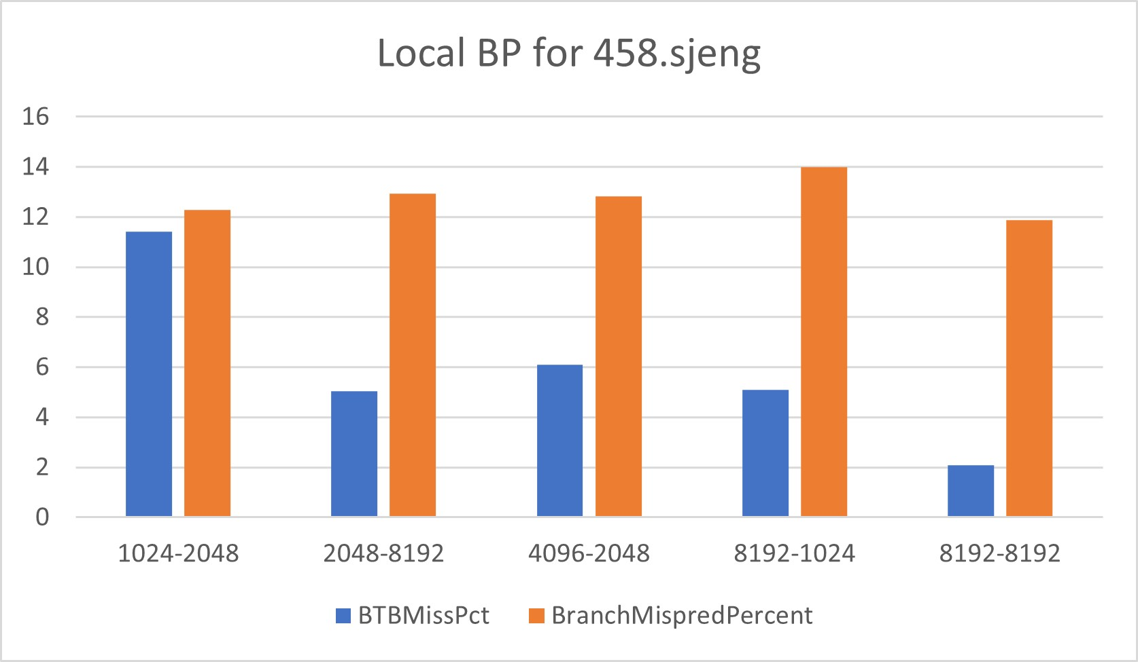
Local BP for 458.sjeng
There is decrease in BTB miss percentage with increase in both BTB entries and local predictor size. A very slight variation is observed in branch miss prediction percentage with changes in the BTB entries and local predictor size.
However as the predictors size decreases, mispredictions have considerable increased as you can see in the 8192-1024 configuration.

Slide 20
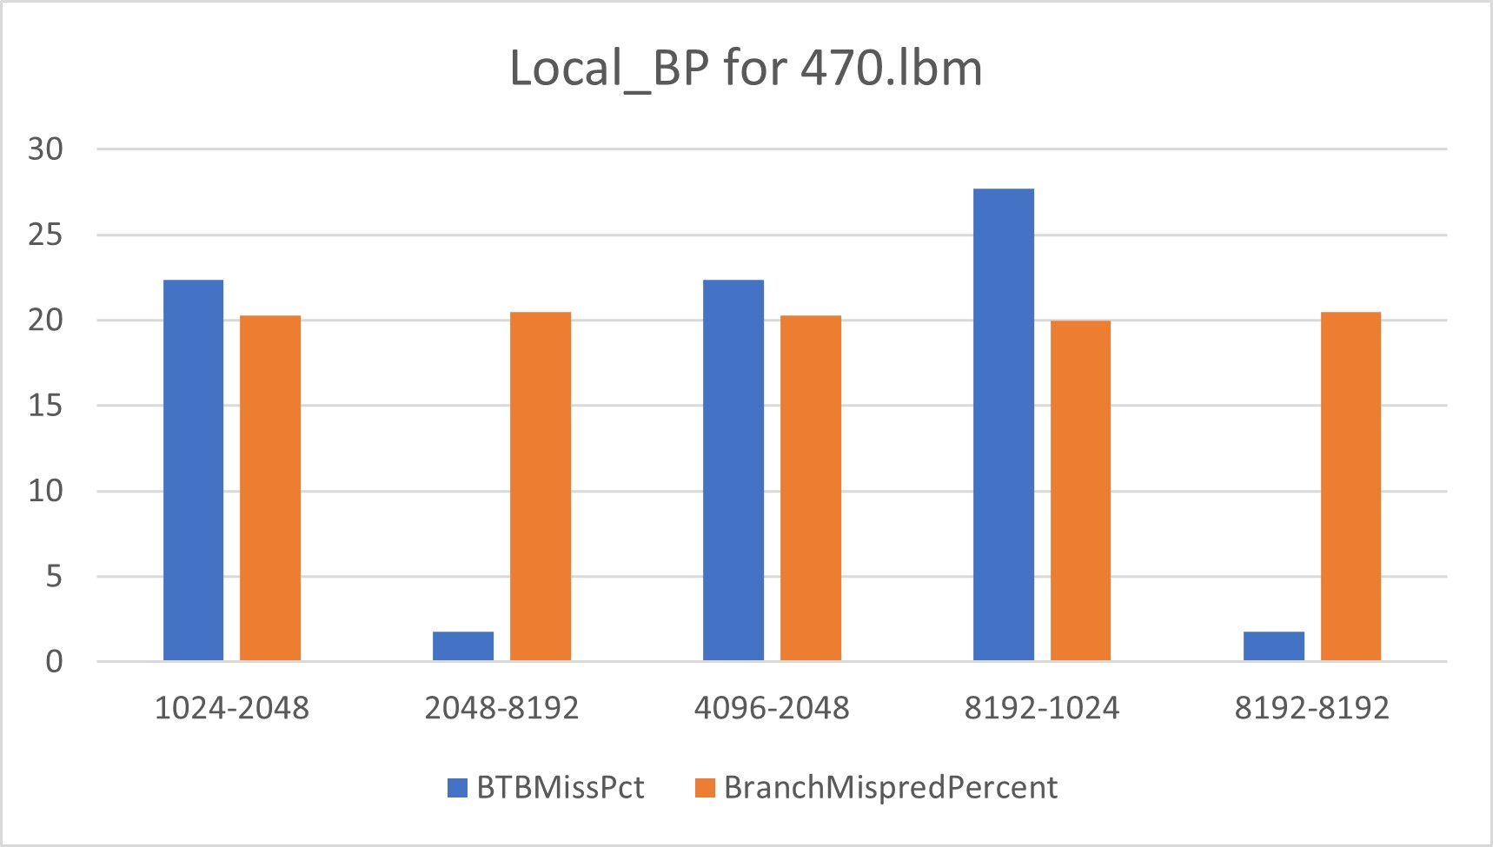
Local BP for 470.lbm
One of the anomalies observed for this specific benchmark is for the 8192-1024 configuration where the
There is decrease in BTB miss percentage trend with increase local predictor size and branch miss prediction percentage stays constant with changes in the BTB entries and local predictor size.

Slide 21
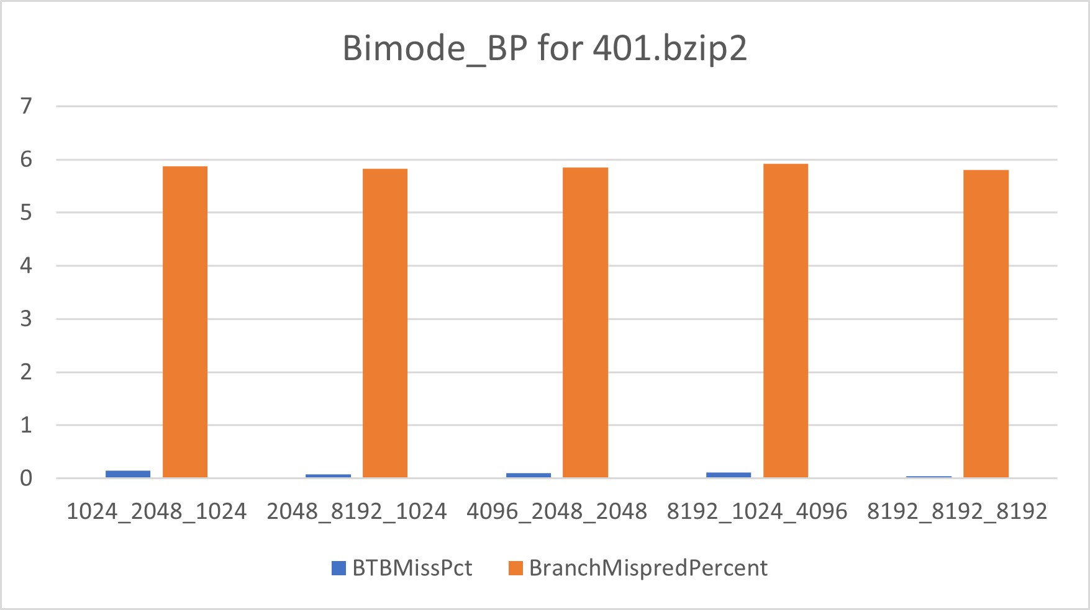
Bi-mode BP for 401
There is not much variation observed in BTB miss percentage and branch miss prediction percentage with changes in the BTB entries, global predictor size and choice predictor size.
However, a smaller global predictor size can lead to relatively more mispredictions; the same can be observed form the configuration “8192_1024_4096”.

Slide 22
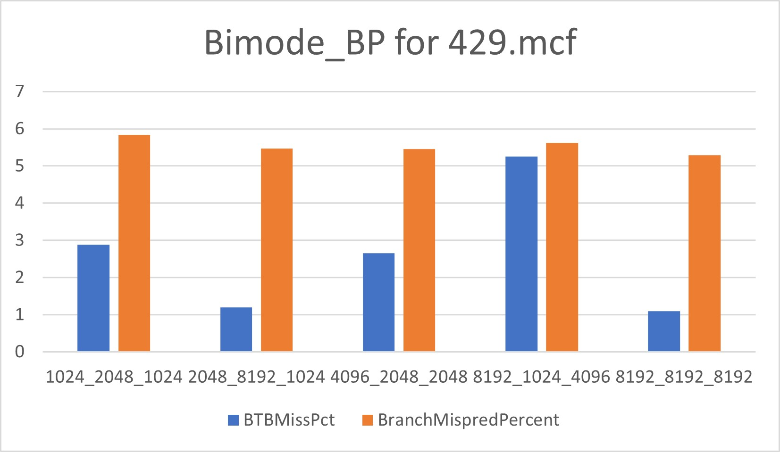
Bi-mode BP for 429
There is decreasing trend in BTB miss percentage with increase in global predictor size.
Branch miss prediction percentage doesn’t change much with changes in the BTB entries, global predictor size and choice predictor size. But it seems to be the least for the for biggest sizes of the predictor.

Slide 23
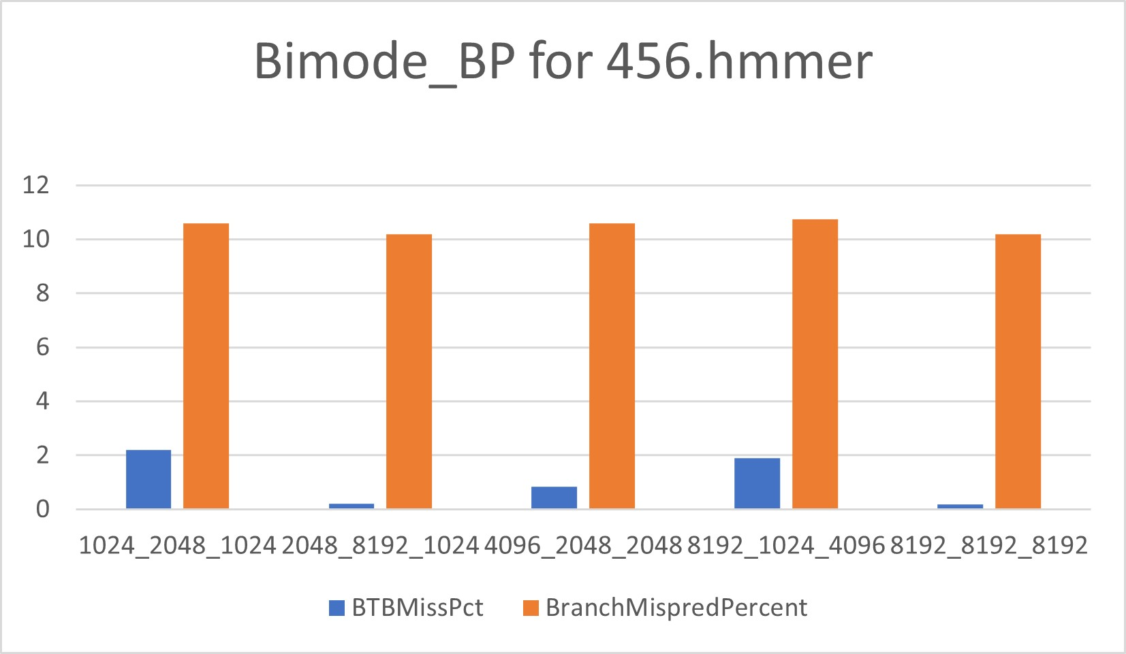
Bi-mode BP for 456
With Increase in BTB entries, the BTB miss percentage seem to reduce, but that doesn’t seem to be the only factor, for bigger BTB buffer and smaller Predictor sizes the miss percentage is seen to worsen; that is increase.

Slide 24
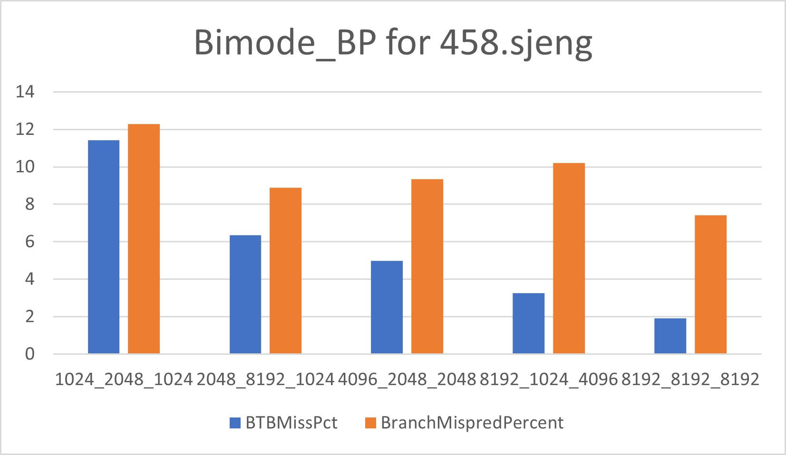
Bi-mode BP for 458
There is decrease in BTB miss percentage with increase in the BTB entries, global predictor size and choice predictor size
The branch miss prediction percentage has a slight variation with changes in the BTB entries, global predictor size and choice predictor size.

Slide 25
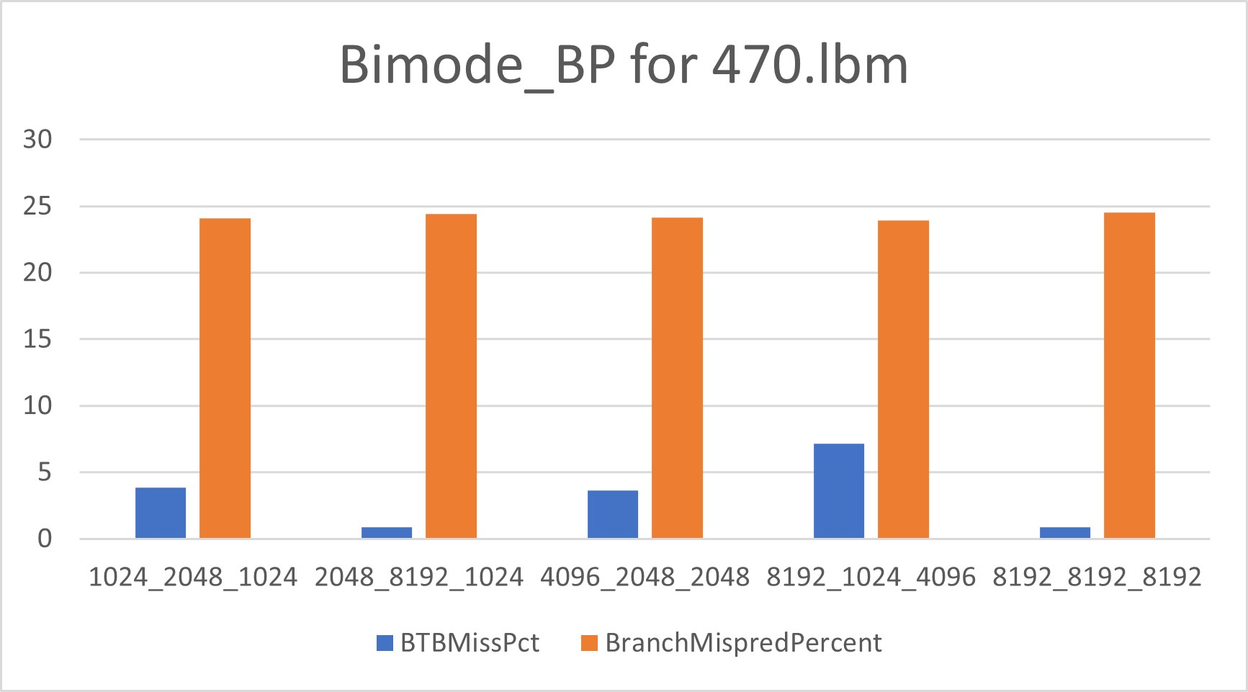
Bi-mode BP for 470
There is decrease in BTB miss percentage with increase in global predictor size values and branch miss prediction percentage stays constant with changes in the BTB entries, global predictor size and choice predictor size.

Slide 26
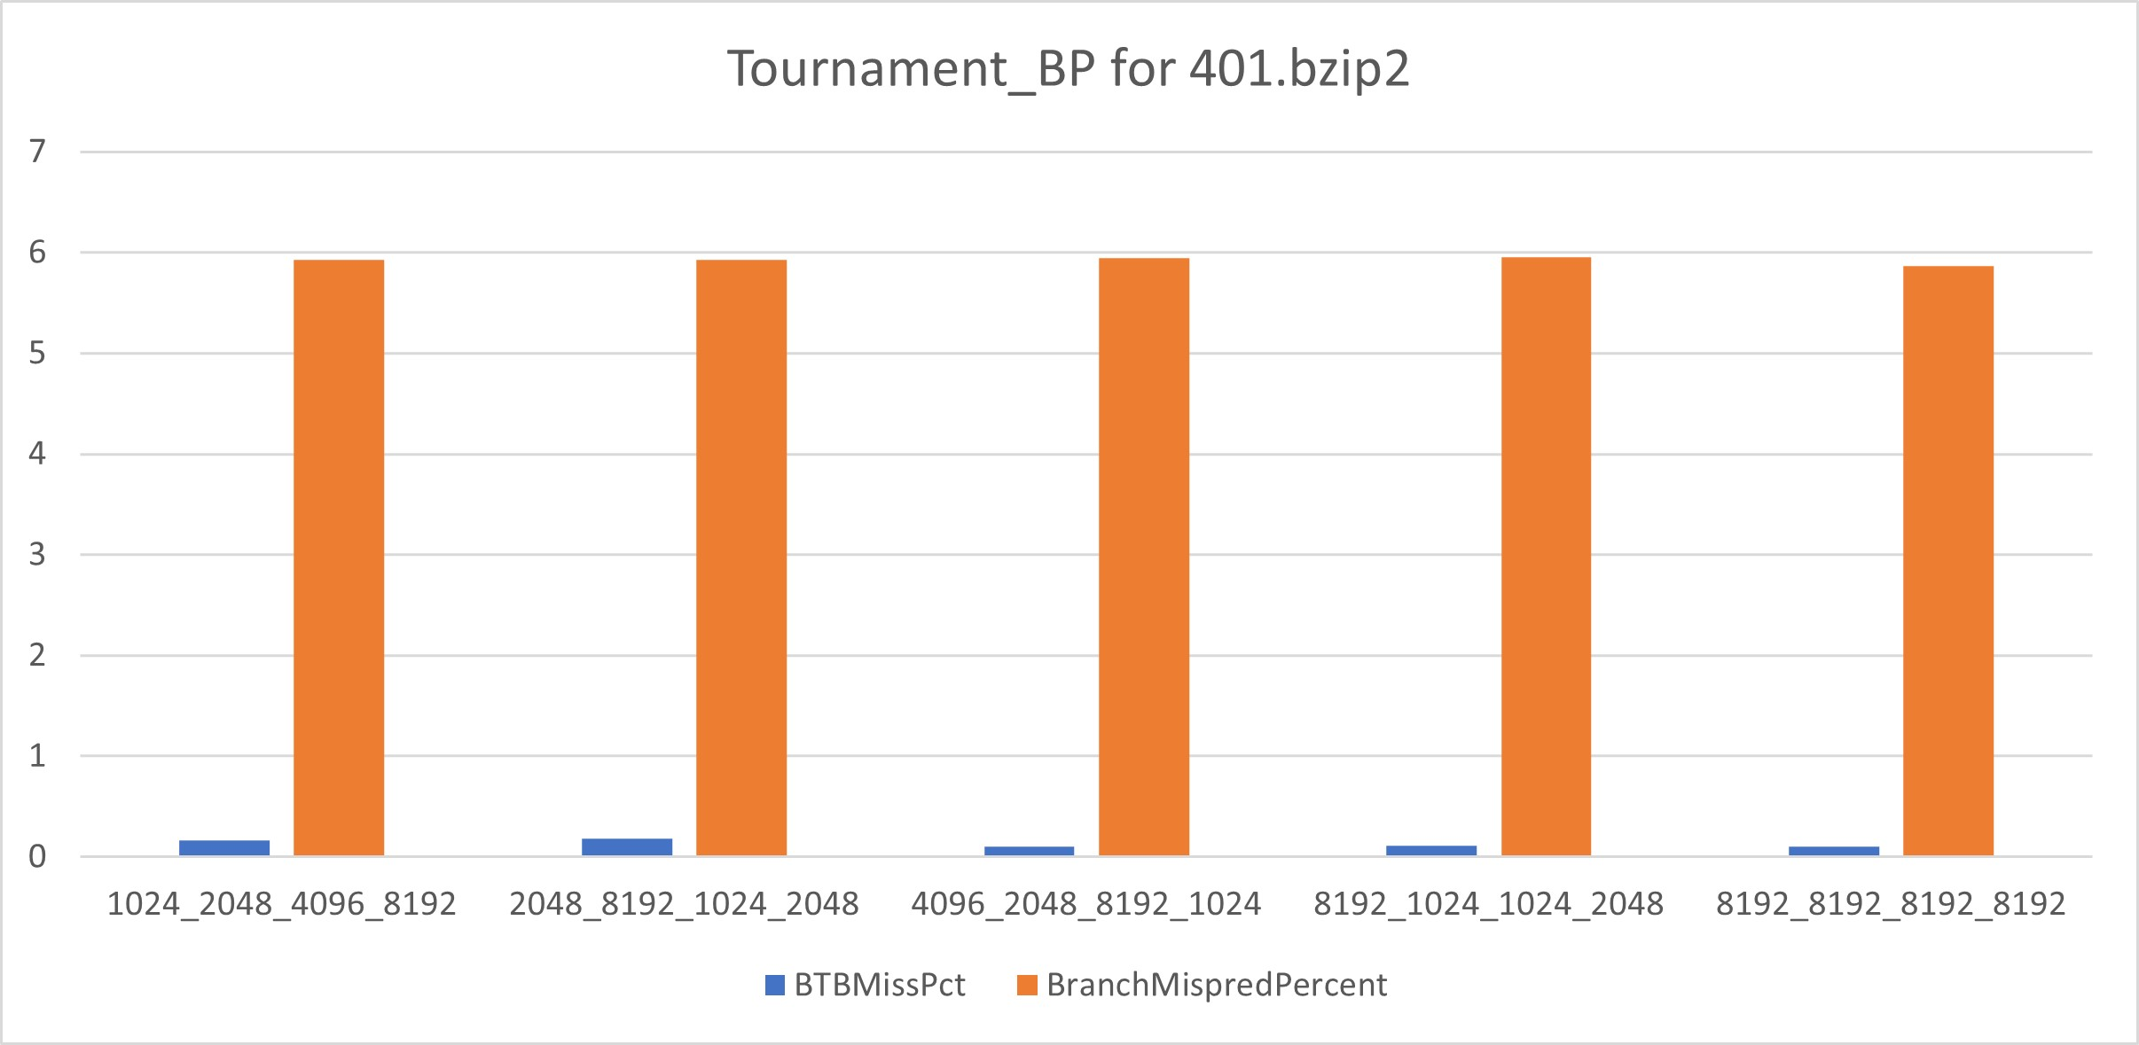
Tournament BP for 401
There is not much variation in BTB miss percentage and branch miss prediction percentage with changes in the BTB entries, local predictor size, global predictor size and choice predictor size.
However as the

Slide 27
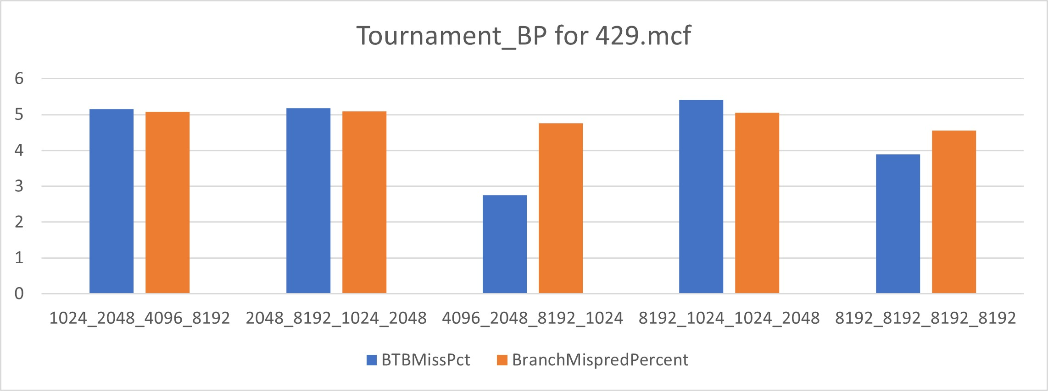
Tournament BP for 429
There is irregular trend in BTB miss percentage and branch miss prediction percentage is constant with changes in the BTB entries, local predictor size, global predictor size and choice predictor size.
Between configurations “4096_2048_8192_1024” and “8192_8192_8192_8192” its is seen that with a smaller BTB buffer and smaller local predictor we were still able to achieve a better miss percent and almost the same misprediction rate.

Slide 28
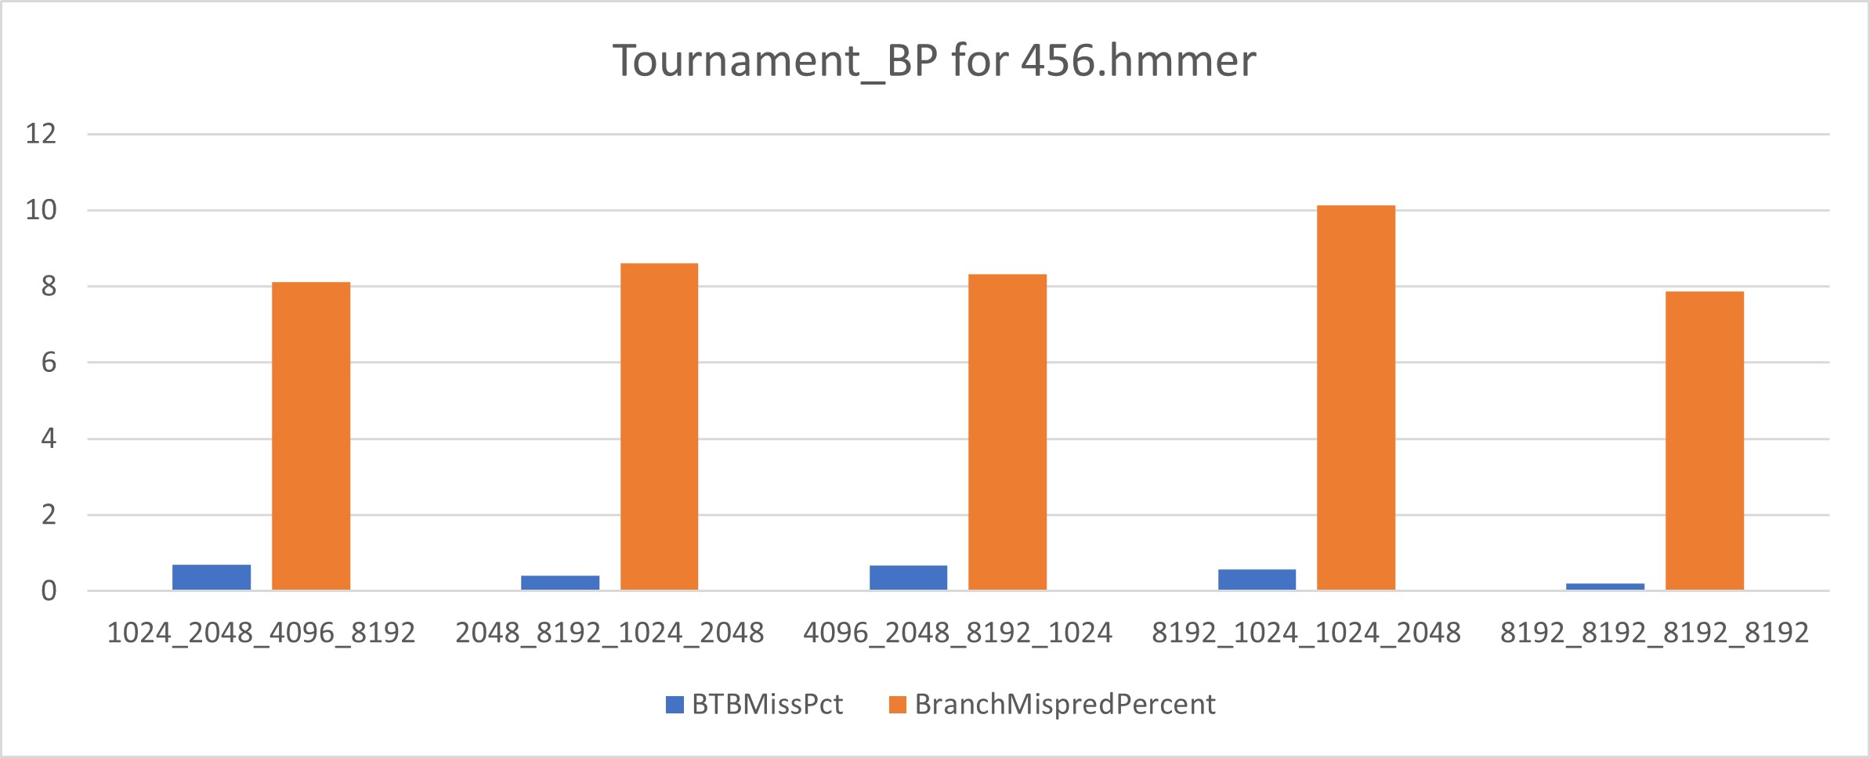
Tournament BP for 456
There is slight variation in BTB miss percentage and branch miss prediction percentage with changes in the BTB entries, local predictor size, global predictor size and choice predictor size.
Best values have been observed when all the considered parameters are at their maximum. See configuration “8192_8192_8192_8192”.

Slide 29
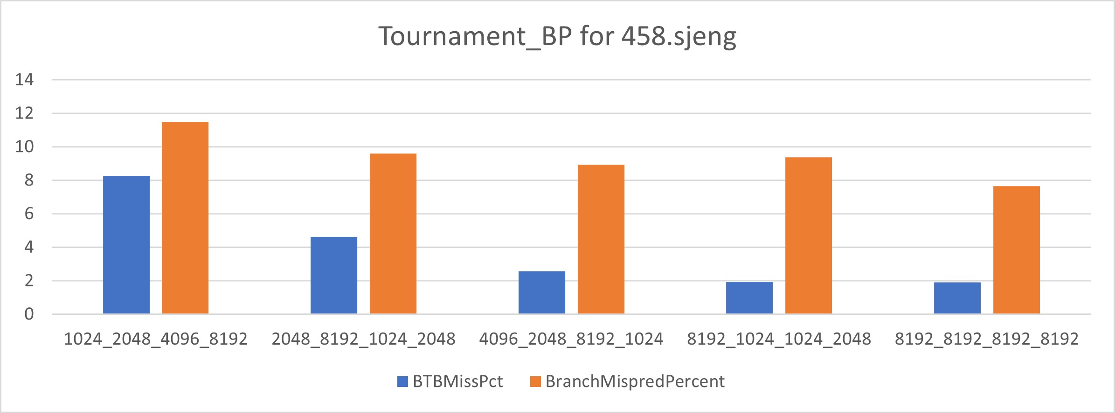
Tournament BP for 458
There is decreasing trend on in BTB miss percentage and branch miss prediction percentage with increasing trend in the BTB entries, local predictor size, global predictor size and choice predictor size.

Slide 30
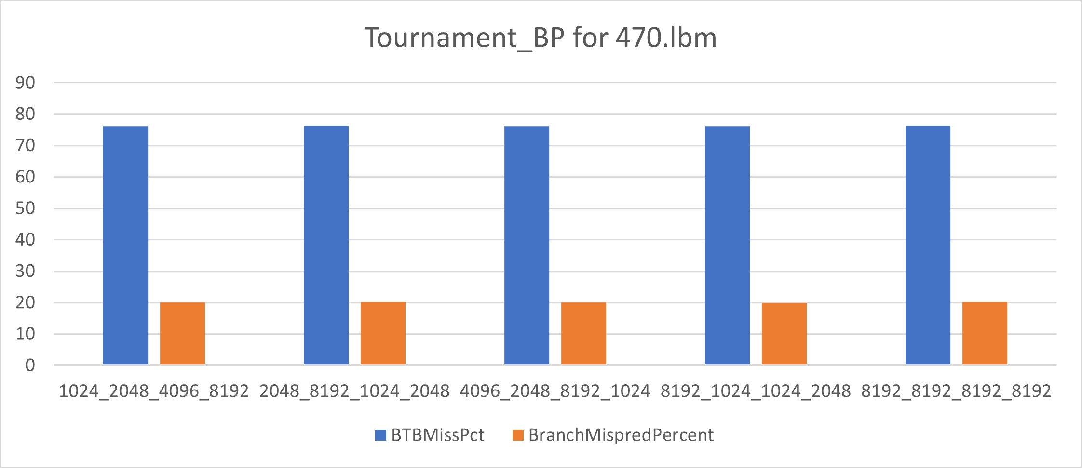
Tournament BP for 470
There is no variation in BTB miss percentage and branch miss prediction percentage with changes in the BTB entries, local predictor size, global predictor size and choice predictor size.

Slide 31
Additional Observations
For benchmark 401.bzip2, the changes in the BTB miss percentage is negligible and Branch miss prediction percentage is high for all Local BP, Tournament BP and BiMode BP.
For 470.lbm, BTB miss percentage is very high for Local BP and Tournament BP but for BiMode BP it is very little.

Slide 32
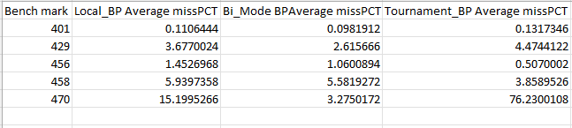
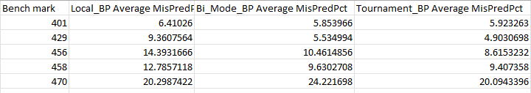
Conclusion Part-1
Finally, we have used all the accumulated data to derive the average BTBmissPCT and BranchMisPred values of each of the predictor on all the five benchmarks.
As it can be inferred from data, Tournament Branch Predictor is the most efficient Branch Predictor when tested over all the benchmarks.

Slide 33
Conclusion Part-2
The performance of a branch predictor depends on several factors such as the characteristics of the program being executed, the memory hierarchy of the system, and the design of the predictor itself.
Tournament BP has a combination of Local, Global and Choice predictor sizes which makes it more accurate than Local BP and Bi-Mode BP.
Tournament BP can be easily scaled to handle large branch history tables, making it well-suited for modern processors with deep pipelines and large instruction windows.
Tournament BP is adaptable, which means it adjusts itself according to the program.
Overall, Tournament BP has better edge over Local BP and BiMode BP because it has higher accuracy, is more adaptable and can be implemented with acceptable complexity on modern processors.

